Slide 1

Detect & Alert Unauthorized Weapon Usage with Haar Cascade and YOLOv7
TEAM ID: CSEA13
Authors:
Aravind R. K. (RA1911003040017)
Shriram G. (RA1911003040059)
V. Anand Arun (RA1911003040115)
Dr. Chitra P. (Faculty Guide)

Slide 2
INTRODUCTION
Weapons in public places pose a significant threat to public safety
Rise in violent crimes has emphasized the need for advanced security systems
Traditional security systems are limited in their ability to detect concealed weapons
Machine learning and computer vision algorithms can enhance public safety by detecting weapons in real-time
The proposed system combines YOLOv7 and Haar Cascade algorithms for weapon detection and face recognition, respectively
The system offers a reliable and efficient solution to enhance security measures in various applications.

Slide 3
MOTIVATION
Need for advanced security systems to ensure public safety
Develop reliable and effective system for weapon detection and face recognition
Implementation in various applications such as airports, public transportation, and public events
Failure to detect weapons can result in catastrophic consequences
Negative impact on public confidence and increased fear
Develop advanced security systems for real-time threat detection
Proposed system using Haar Cascade and YOLOv7 algorithms
Enhance public safety

Slide 4
LITERATURE SURVEY
PAPER TITLE WITH PUBLISHED INFORMATION | METHODOLOGY | PERFORMANCE ANALYSIS | LIMITATIONS
“Weapon Detection Using YOLO V3 for Smart Surveillance System” Narejo, S., Pandey, B., Esenarro vargas, D., Rodriguez, C., & Anjum, M. R. Mathematical Problems in Engineering, 2021 | In this work, it is attempted to develop an integrated framework for reconnaissance security that distinguishes the weapons progressively, if identification is positively true it will caution/brief the security personals. | YOLO V3 object detection to identify the unsafe weapon and can also alert the human administrator.​​ | The YOLOv3 AP does indicate a trade-off between speed and accuracy.
“Firearm Detection using Convolutional Neural Networks” RF de Azevedo Kanehisa ICAART, 2019 | In this method automatic detection of dangerous situations in CCTV systems, with the help of image processing and machine learning. | This work demonstrated the feasibility of using CNNs to create a generic firearm detector. The method used proved to be robust. | It is not ready to be applied in real time.
“​​Development and Optimization of Deep Learning Models for Weapon Detection in Surveillance Videos” Ahmed, S.; Bhatti, M.T.; Khan, M.G.; Lövström, B.; Shahid, M. Appl. Sci. 2022 | The Scaled-YOLOv4 algorithm is implemented for high precision and improved FPS over existing methods. | the models presented give very good performance in terms of precision and inference time if implemented over a high-performance GPU (such as RTX 2080TI). | Further improvement and optimization is needed for improved accuracy and superior FPS.
“Digital Image Processing” Mohana, International Conference on I-SMAC (IoT in Social, Mobile, Analytics and Cloud), 2018 | YOLO V3 "You Only Look Once" object detection model have been implemented by training it in custom dataset. | Addressing the concealed weapon detection problem.​​ | The YOLOv3 AP shows a compromise between speed and accuracy for YOLO usage.
“Weapon Detection in Realtime CCTV Videos Using Deep Learning” M. T. Bhatti, M. G. Khan, M. Aslam and M. J. Fiaz IEEE Access, 2021 | VGG16, Inception-V3, Inception-ResnetV2, SSDMobileNetV1, Faster-RCNN Inception-ResnetV2 (FRIRv2), YOLOv3, and YOLOv4 are a few of the methods employed. | Yolov4 stands out the most, producing an F1-score of 91% and a mean average precision that is 91.73% higher than what was previously achieved. | False positives and negatives need to be further reduced because they need to be improved.

Slide 5
LITERATURE SURVEY
PAPER TITLE WITH PUBLISHED INFORMATION | METHODOLOGY | PERFORMANCE ANALYSIS | LIMITATIONS
"Weapon Detection using Artificial Intelligence and Deep Learning for Security Applications“ H. Jain, A. Vikram, Mohana, A. Kashyap and A. Jain International Conference on Electronics and Sustainable Communication Systems, 2020 | This study uses the SSD and Faster RCNN convolution neural network (CNN) methods to accomplish automatic gun (or weapon) identification. | Both methods are quite accurate. | The trade-off between accuracy and speed can be used to determine application in practical settings.
“Firearm Detection from Surveillance Cameras Using Image Processing and Machine Learning Techniques” Gelana, F., Yadav, A. Smart Innovations in Communication and Computational Sciences, 2018 | The classification of an object as treatment (gun) or not is done by a Tensorflow based implementation of the convolutional neural network (CNN) algorithm. | The classification obtained through the proposed approach is 97.78% accurate. | False positive findings are numerous.
“Brightness guided preprocessing for automatic cold steel weapon detection in surveillance videos with deep learning” Castillo, A., Tabik, S., Pérez, F., Olmos, R., & Herrera, F. Neurocomputing, 2019 | The purpose of this study is twofold: (i) Develop an automatic cold weapon detection model for video surveillance using convolutional neuronal network (CNN)s (ii) strengthen its robustness under lighting conditions by providing a light-guided preprocessing procedure called DaCoLT (Darkening and Contrast in Learning and Testing) | The resulting detection model provides excellent results as a cold steel weapon detector and as an automatic alarm system for CCTV. | Weapons are not detectable in external scenarios.
“WARDIC - an enhanced architecture of ConvNets and Singular Classifiers has shown promising performance in weapons detection in surveillance streams” Bhatt, A., & Ganatra, A. Engineered Science, 2022 | WARDIC - an enhanced architecture of ConvNets and Singular Classifiers has shown promising performance in weapons detection in surveillance streams. | Cross-validations of the grader using 5-Fold and 10-Fold CVs showed precision scores of 99.27% and 99.46%, respectively, with linear complexity. | The data is replicated repeatedly.
“Weapon Detection for Particular Scenarios Using Deep Learning” Vallez, N., Velasco-Mata, A., Corroto, J.J., Deniz, O. Pattern Recognition and Image Analysis, 2019 | It is suggested using the false alarms in the new scenario to drive a deep auto-encoder and to model them. It acts as a filter which checks whether the detector output is one of its typical false positives or not based on the recon error measured using Mean Square Error (MSE) and Peak Signal to Noise Ratio (PSNR). | The results indicate a reduction in the number of FPs by as much as 37.9% in combination with the PSNR error while maintaining the same detection capacity. | it is highly sensitive to biases in brightness.

Slide 6
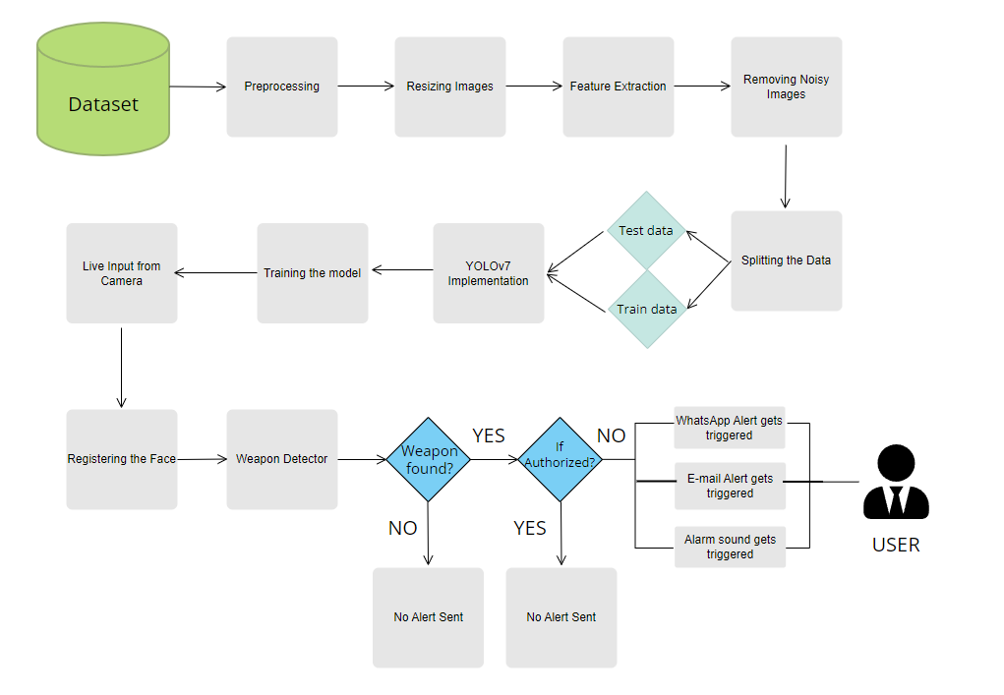
ARCHITECTURE

Slide 7
METHODOLOGY
Proposed Intelligent Security System:
YOLOv7 algorithm for weapon detection
Haar Cascade algorithm for face recognition
Alarm sound alert for immediate response
Whatsapp and email alert system for security personnel
Designed to enhance public safety in various applications
The proposed intelligent security system uses advanced algorithms such as YOLOv7 and Haar Cascade for weapon detection and face recognition respectively. An alarm sound alert is also included for immediate response in case of any potential threat. In addition, the system is equipped with a Whatsapp and email alert system to notify security personnel in real-time.
The system is designed to enhance public safety in various applications such as airports, public transportation, and public events. Its reliable and effective components ensure potential threats are detected and security personnel can respond quickly to prevent harm from occurring.

Slide 8
METHODOLOGY
Overview of the dataset used for training and testing the system:
Custom dataset of 714 images of various weapons was created for training the YOLOv7 weapon detection system.
Open-source labeling tool, LabelImg, was used to manually label the dataset by drawing bounding boxes and assigning labels from a predefined list of weapon categories.
Dataset consisted of nine weapon categories: Handgun, Sword, SMG, Sniper, Automatic Rifle, Bazooka, Grenade Launcher, Knife, and Shotgun.
Each image was labeled with all the weapons present in the image, and negative examples were also included.
Annotators were employed to label each image autonomously, and discrepancies were resolved through collaborative discussion.
The dataset was split into a training set of 571 images and a validation set of 143 images.

Slide 9
METHODOLOGY
Overview of the dataset used for training and testing the system:
Preprocessing techniques were used to ensure the quality of the dataset, including checking for size, format, and quality, cleaning irrelevant background, and balancing positive and negative samples.
Images were resized to a common size of 640 x 640 pixels to make them suitable for the model training process.
Input images were fine-tuned by applying data augmentation and normalization techniques, such as rotation, flipping, and scaling, to generate more training samples and make the model more robust.
A model was built by combining YOLOv7 and Haar Cascade algorithms for weapon and face detection, respectively, chosen for their high accuracy and real-time detection capabilities.

Slide 10
METHODOLOGY
Explanation of deep learning techniques:
Deep learning techniques have been used in the proposed intelligent security system to achieve high accuracy in weapon identification and face recognition.
The convolutional neural network (CNN) is a key deep learning technique used for weapon identification.
CNN is a type of neural network that is particularly effective in image recognition and classification tasks, such as detecting weapons in images.
The YOLOv7 algorithm, which is used in our system for weapon detection, is based on a CNN architecture.
YOLOv7 uses a single deep neural network to identify weapons in real-time by dividing the image into a grid and predicting bounding boxes and probabilities for each grid cell.
By using CNN and YOLOv7, our system achieves high accuracy and recall rates for weapon detection, making it a reliable and effective solution for enhancing public safety in various settings.

Slide 11
METHODOLOGY
Model Evaluation Metrics:
Accuracy, precision, and recall are key metrics used for evaluating the performance of classification models. Accuracy ranges from 0 to 1, with 1 indicating perfect accuracy.
Accuracy: Total number of correct predictions divided by the total number of predictions
Precision: Proportion of true positives to all positive predictions made by the model
Precision is calculated as True Positives / (True Positives + False Positives)
Recall: Proportion of true positives in the dataset that the model correctly identified
Recall is calculated as True Positives / (True Positives + False Negatives)

Slide 12
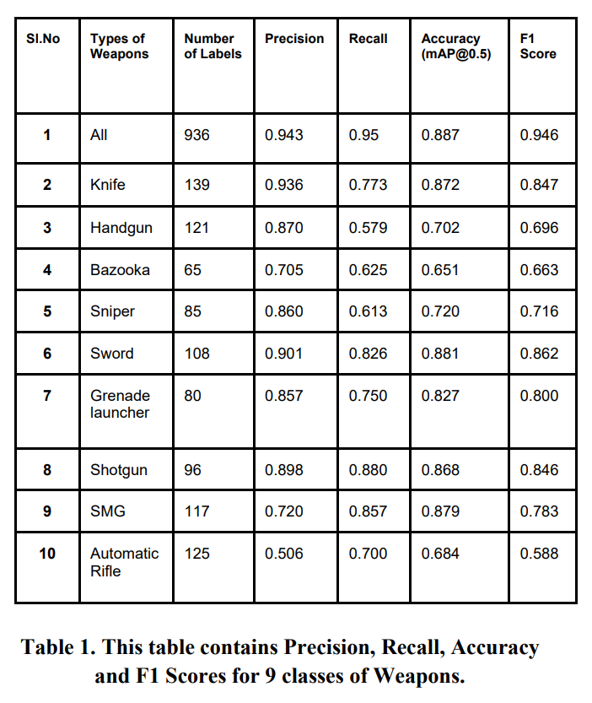
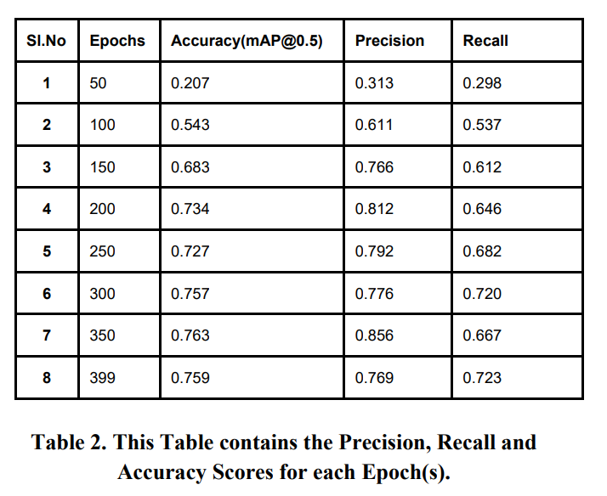
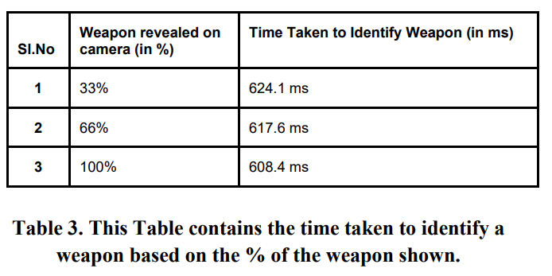
EVALUATION RESULTS

Slide 13
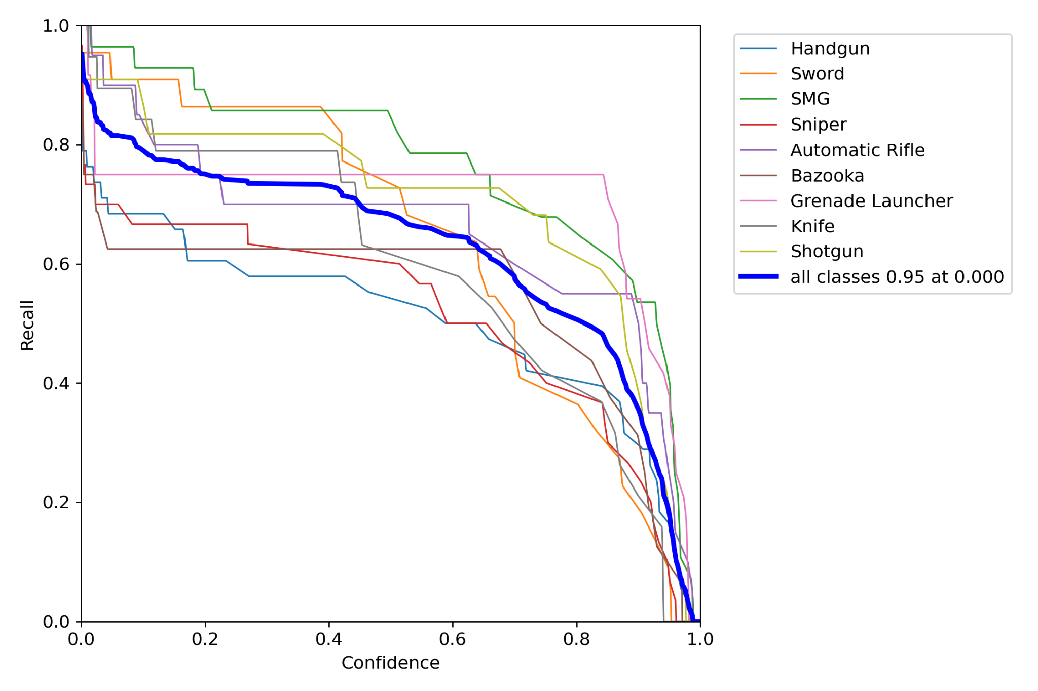
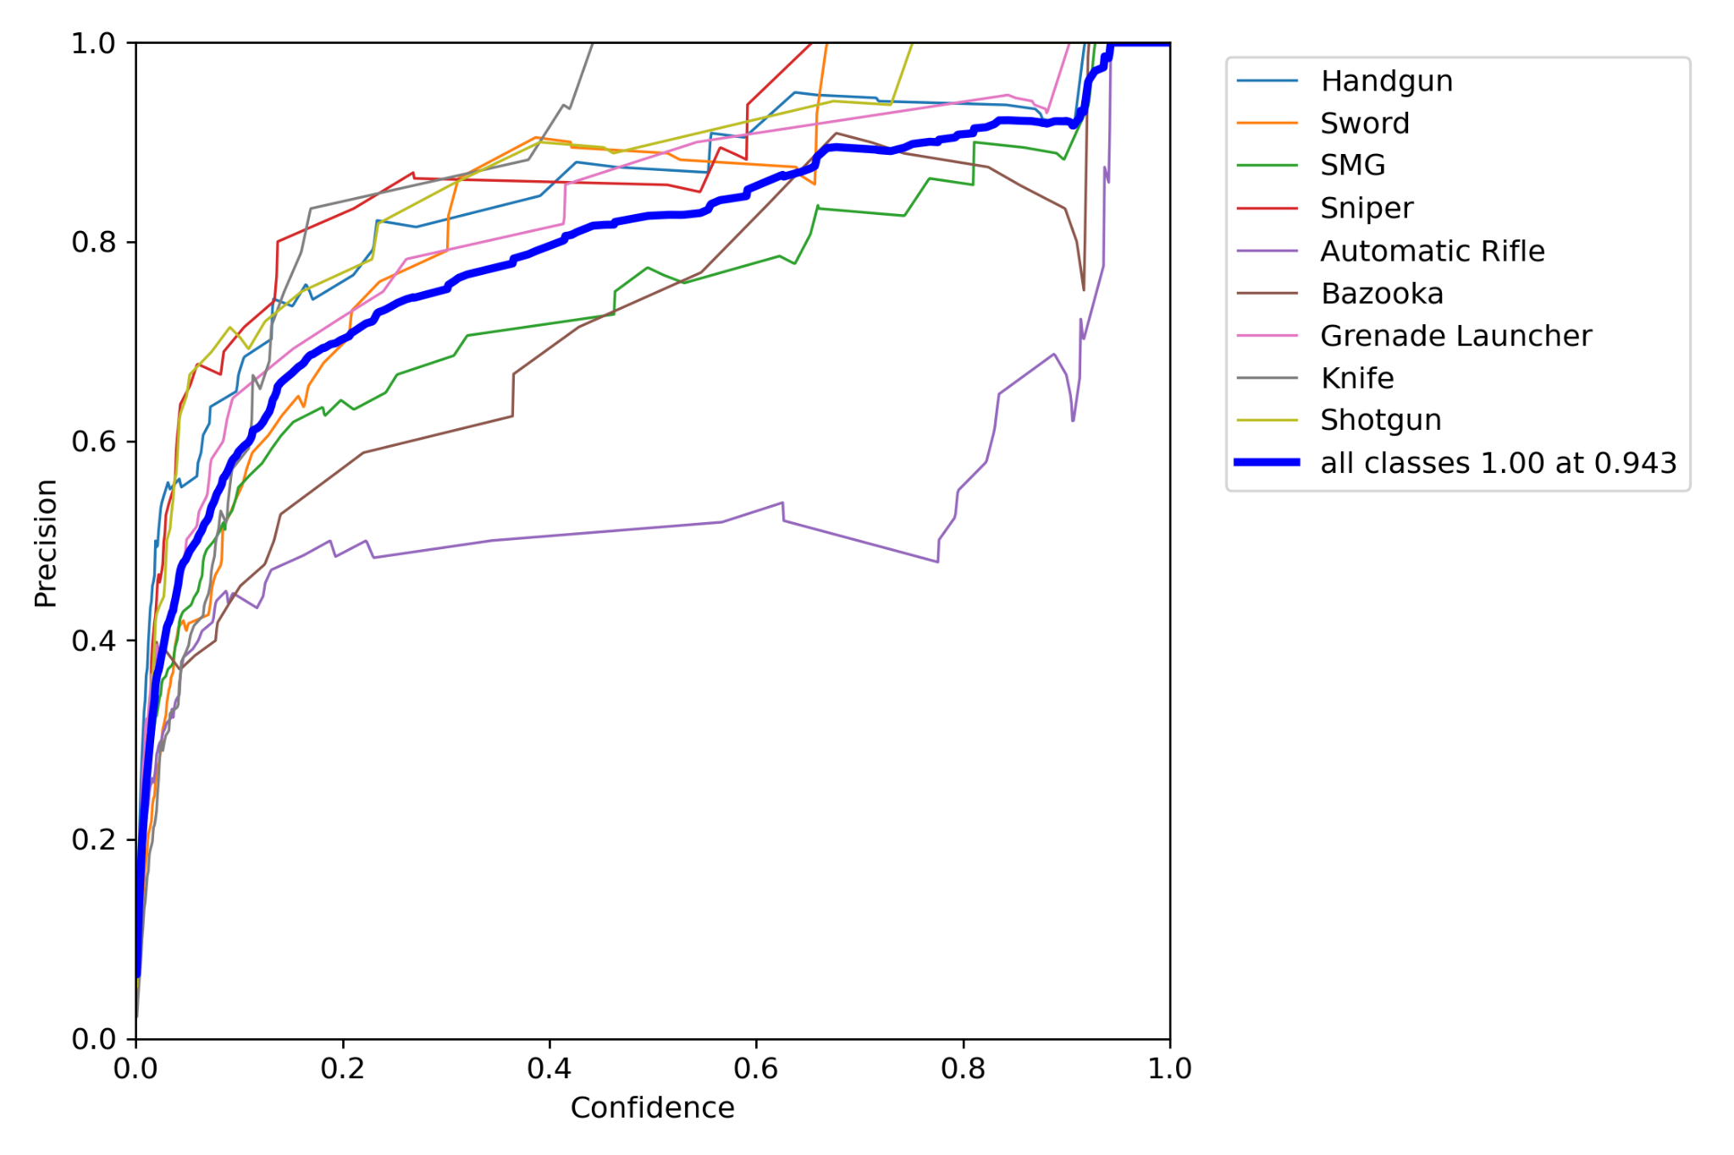
EVALUATION RESULTS
Recall Curve
Precision Curve

Slide 14
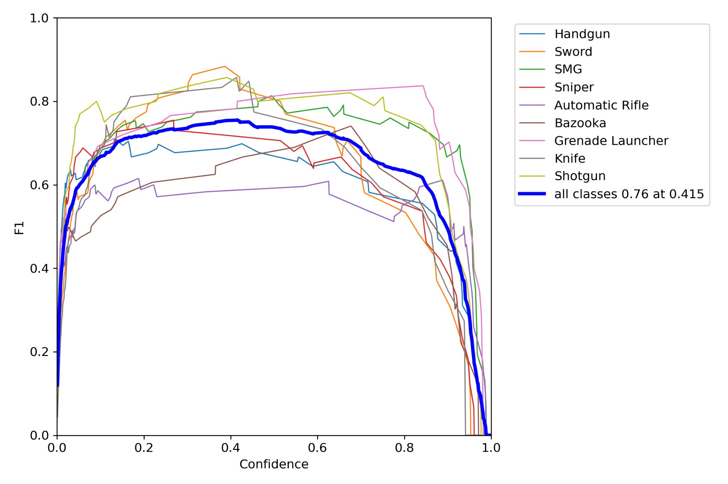
EVALUATION RESULTS
F1 Curve

Slide 15
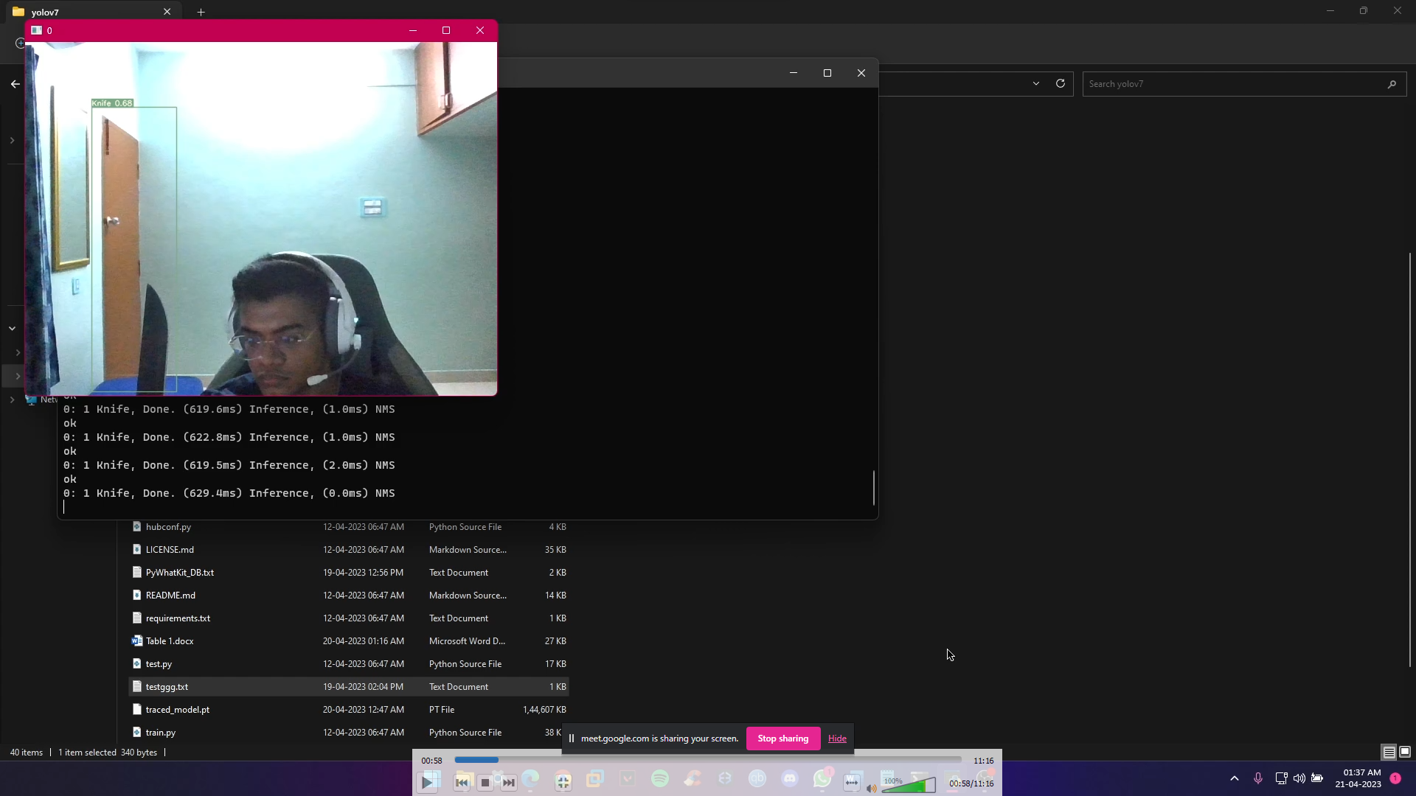
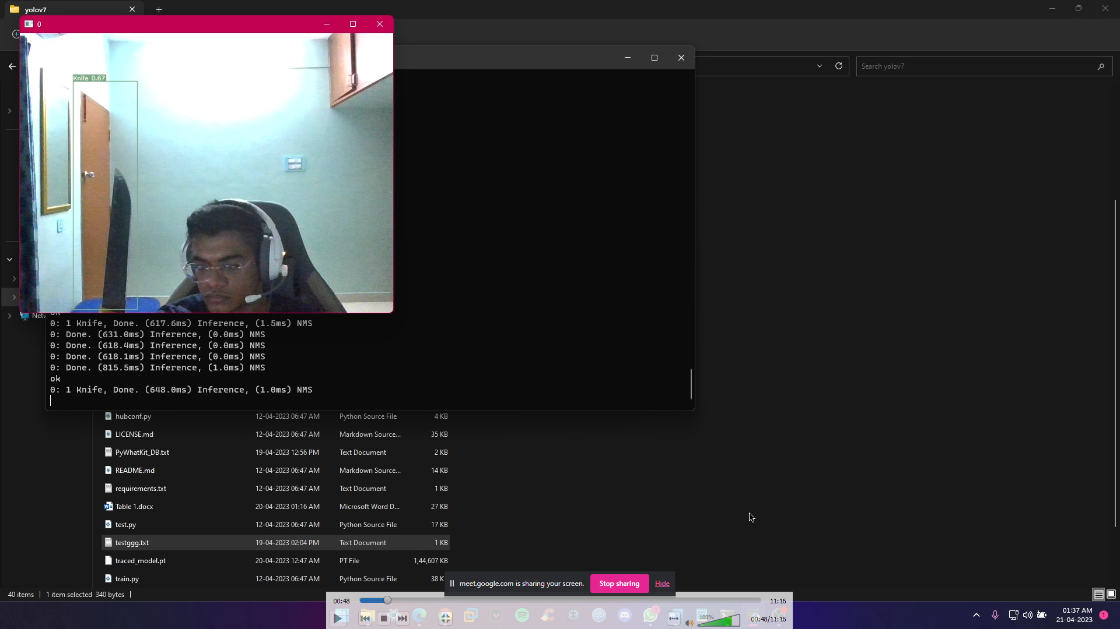
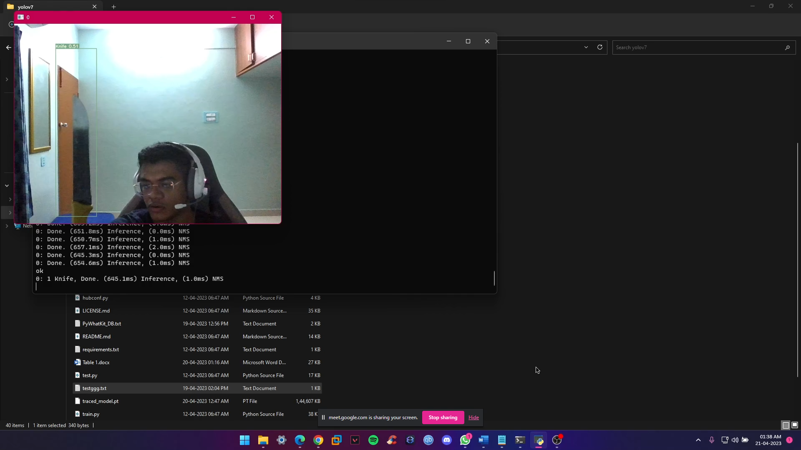
EVALUATION RESULTS
30% of Weapon Shown
60% of Weapon Shown
100% of Weapon Shown

Slide 16
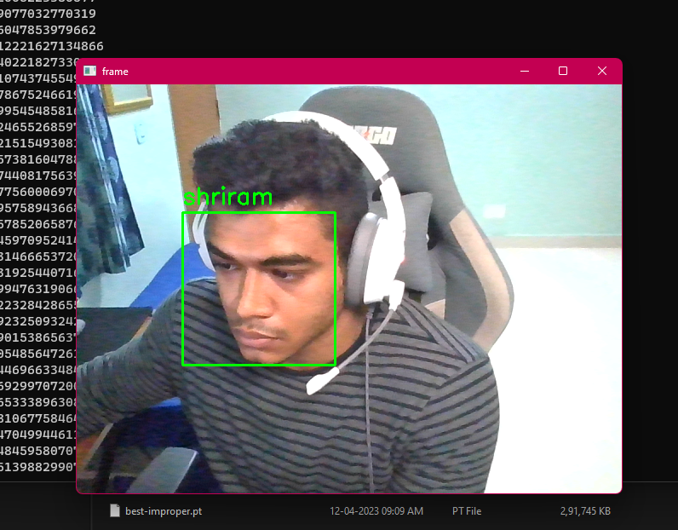
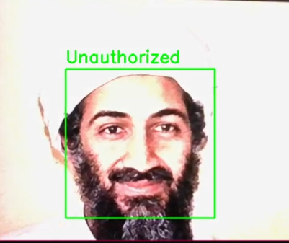
EVALUATION RESULTS
Authorized User
Unauthorized User

Slide 17

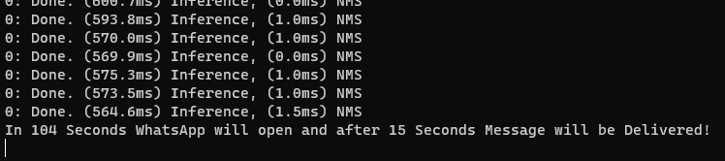

EVALUATION RESULTS
EMail Alert
WhatsApp Alert
*Sound alert will be played as well.

Slide 18
STRENGTHS AND LIMITATIONS
Our proposed system for weapon detection using YOLOv7 and Haar Cascade algorithms has several strengths and limitations that are important to consider.
Strengths:
Accurate weapon detection: The system has shown high accuracy in detecting weapons, making it a reliable tool for enhancing public safety.
Real-time alert system: The system can alert security personnel in real-time, allowing for immediate action to be taken in response to a potential threat.
Limitations:
Concealed weapons detection: The system may not be as effective in detecting concealed weapons, which can be a limitation in certain situations.
False alarms: The system may produce false alarms, which can lead to unnecessary panic and cause disruptions to public spaces.
Despite these limitations, our proposed system has several strengths that make it a valuable tool for enhancing public safety in various settings. Future research and development can focus on addressing the limitations of the system to further improve its effectiveness.

Slide 19
APPLICATIONS AND BENEFITS
Overview:
Our proposed system for weapon detection and face recognition has the potential to enhance public safety by providing an extra layer of security and reducing response time in case of a threat.
Applications:
The system can be implemented in various settings, such as:
Airports: to detect any unauthorized weapon or individual with a potential threat
Train stations: to monitor the crowd and identify any suspicious activity
Schools: to ensure the safety of students and staff
Shopping malls: to prevent any potential threats and ensure the safety of the customers

Slide 20
APPLICATIONS AND BENEFITS
Benefits:
The benefits of our system include:
Real-time detection of weapons and faces, which can reduce response time in case of a threat
Enhanced security measures by providing an extra layer of security
Improved safety for individuals and public spaces
Potential prevention of crimes or threats before they occur, reducing the need for reactive measures
Overall, our proposed system has various applications and benefits that can enhance public safety in different settings. By implementing this system, we can provide better security measures and prevent potential threats, ensuring the safety of individuals and public spaces.

Slide 21
CONCLUSION
Proposed intelligent security system combines YOLO v7 and Haar Cascade for weapon detection and face recognition, respectively
System is able to detect weapons, recognize faces, and send WhatsApp and email notifications when a weapon is detected
High accuracy and recall rate achieved for both weapon detection and face recognition
Notification and alert system provides real-time notification to users when a weapon is detected
System can be implemented in various public settings to enhance security measures and provide an extra layer of safety
Potential to prevent potential threats and ensure public safety

Slide 22
FUTURE WORK
Improve the accuracy of the face recognition algorithm by using more advanced methods such as deep learning techniques
Increase the detection rate of the system for detecting concealed weapons
Integrate the system with a centralized monitoring system to provide a more comprehensive security solution
Explore the potential of incorporating other technologies such as thermal imaging and audio detection to enhance the system's capabilities
Conduct further research to evaluate the system's effectiveness and efficiency in real-world scenarios.

Slide 23
REFERENCES
[1]. Redmon, J., & Farhadi, A. (2018). YOLOv3: An Incremental Improvement. arXiv preprint arXiv:1804.02767.
[2]. Viola, P., & Jones, M. (2004). Robust real-time face detection. International journal of computer vision, 57(2), 137-154.
[3]. Singh, A., Mishra, D., & Singh, V. K. (2018). YOLOv2 vs YOLOv3 vs Mask R CNN vs Deeplab Xception: Which one is Better for Object Detection. arXiv preprint arXiv:1902.06087.
[4]. Huang, G., Liu, Z., Van Der Maaten, L., & Weinberger, K. Q. (2017). Densely connected convolutional networks. In Proceedings of the IEEE conference on computer vision and pattern recognition (pp. 4700-4708).
[5]. Ren, S., He, K., Girshick, R., & Sun, J. (2015). Faster RCNN: towards real-time object detection with region proposal networks. Advances in neural information processing systems (pp. 91-99).

Slide 24
REFERENCES
[6]. Sonkusare, S., & Sapkal, A. (2018). Real-time face recognition using Haar Cascade classifier and OpenCV. In 2018 4th International Conference on Computing Communication Control and Automation (ICCUBEA) (pp. 1- 6). IEEE.
[7]. Adebayo, A., Gilani, A., & Moustafa, N. (2020). Deep Learning for Computer Vision: A Comparative Approach. arXiv preprint arXiv:2007.02100.
[8]. Sánchez-Matilla, R., Pérez, J., & Jara, A. J. (2019). A survey of Deep Learning for Big Data: architectures, integration and collaboration. ACM Computing Surveys (CSUR), 52(5), 1-36.
[9]. Alom, M. Z., Yakopcic, C., Hasan, M., Taha, T. M., & Asari, V. K. (2019). Recurrent residual convolutional neural network based on U-Net (R2U-Net) for medical image segmentation. arXiv preprint arXiv:1802.06955.
[10]. Jain, S., & Kanungo, A. (2020). Artificial Intelligence based Weapon Detection System using Deep Learning. arXiv preprint arXiv:2012.01438.

Slide 25
REFERENCES
[11]. Liu, W., Anguelov, D., Erhan, D., Szegedy, C., Reed, S., Fu, C. Y., & Berg, A. C. (2016). SSD: Single Shot MultiBox Detector. In the European Conference on Computer Vision (pp. 21-37). Springer, Cham.
[12]. He, K., Gkioxari, G., Dollár, P., & Girshick, R. (2017). Mask R-CNN. In Proceedings of the IEEE international conference on computer vision (pp. 2961-2969).
[13]. Simonyan, K., & Zisserman, A. (2015). Very deep convolutional networks for large-scale image recognition. arXiv preprint arXiv:1409.1556.
[14]. Girshick, R. (2015). Fast R-CNN. In Proceedings of the IEEE international conference on computer vision
[15]. Zhang, Y., Deng, J., & Ma, H. (2021). A Review on Convolutional Neural Networks for Image Classification. IEEE Access, 9, 152875-152895

Slide 26
THANK YOU

